Slide 1

A Study of Employee Stock Option Pricing in Taiwan
  by
Ling-Chu Lee, Ming-Chun Wang and Chia-ying Chan*

Slide 2
Objectives
What are Employee Stock Options (ESOs)?
ESOs in Taiwan
Pricing ESOs: With and Without Restricted Exercise Price
Factors that Determine the Imposition of Restricted Exercise Price on ESOs

Slide 3
What are the
Employee Stock Options (ESOs)?
A right to buy underlying shares at a certain price during a certain interval
To Firm Employees:
1) Salary Compensation/Remuneration
2) Incentive/Motivation
3) Employee=Shareholder

Slide 4
Practice of various incentive schemes In Taiwan
Cash bonus
Share bonus
Employee Stock Options
Treasury Shares
Interest from Shareholder Trust

Slide 5
What are the ESOs
To Corporate finance perspective:
Share Bonus Vs. Employee Share Options
The Former:
1) Short Term /Long Term Incentive Scheme
2) Depends Upon Past Performance
The Latter:
1) Long Term Incentive Scheme
2) Depends Upon Post Performance

Slide 6
The Issue of ESOs
Furthermore, the issue of the ESOs implies the potential change of company ownership[1] and capital structure[2], which brings a large impact on the firm.
[1] The exercise of ESOs means an increase and diversification of the number of firm shareholders.
[2] The exercise of the ESOs may bring so-called dilution effects to the firm inducing the change of capital structure.

Slide 7
The Impact of Issuing of ESOs in Taiwan
Merits
Better than share bonus
from reporting prospective
Incentive scheme
Demerits
Dilution of the revenue
Income tax to the employees by exercising the options
Possible manipulation effect

Slide 8
The History of ESOs
US: The first inception happened around 1990s’.
The ESOs is considered as “ Incentive Scheme”.
Japan: 1997. Both managers and employees are eligible for the incentive scheme.
Germany: 1996. Likewise.
Taiwan: 2000. ESOs are allowed to set restricted exercise.
Generally follow the FASB 123 reporting. Most of ESOs have lack up period.

Slide 9
The Issue of ESOs In Taiwan
2000: Listed firms were allowed to issue employee stock options.
2007: The adoption of the ESOs schemes should follow Fair price valuation and report as expenses.
Total amount should not exceed 15% of total outstanding shares.
Effective after the application of issuing ESOs to Financial Supervisory Commission being approved.

Slide 10
The Issue of ESOs In Taiwan
Company Act (公司法) No. 167-2
Securities and Exchange Act (證交法) No. 28-3
Business Accounting Act ( 商業會計法) No. 64
Regulations Governing the Offering and Issuance of Securities by Securities Issuers (發行人募集與發行有價證券處理準則)
No. 39 Paper (第39號公報)

Slide 11
Motivation of the paper
With a similar origin to corporate equity warrants, (Eberhart (2005)), ESOs are also important as part of a firm’s stage financing.
However, since the fist inception of the ESOs around 1990s’, literature on this instrument has been scarce. The notable absence of the literature on the ESOs hence gives original motivation of this paper.

Slide 12
Motivation of the paper
The imposition of Restricted exercise provision on ESOs in Taiwan is a unique phenomenon. There is no study focused on this issue.
In year 2007, more than 90 listed firms had issued employee stock options. (Economics Daily)

Slide 13
Contribution of the paper
First attempt to adopt forward-pricing model in pricing ESOs.
First attempt to adopt Reset pricing model to examine the restricted exercise price provision.
First attempt to examine factors determine the decision of imposing restricted exercise price.

Slide 14
Studies on the Incentive Schemes
Design of the Schemes
Jenkins and Seiler (1990), Galbraith and Merrill (1991), Smith and Watts (1992), Gaver and Gaver (1995), Lawrence (2001)).
Performance post the Schemes
Jensen and Murphy (1990), Yermack (1995), Hall and Leibman (1998), Ding and Sun (2001), Kato (2005)
Pricing and accounting of the scheme
Yermack (1997), Aboody and Kasznik (2000), Brenner et al. (2000), Chance et al. (2000), Aboody et al. (2006))

Slide 15
Studies on the ESOs
Studies in Taiwan
Han (2003), Guo et al. (2006), Fan and Chen (2006), Chen (2006), Lin and Hu (2006), Han and Shen (2007)
Hemmer et al. (1996) indicate that the valuation of employee stock options (ESO) has received significant attention from academics and practitioners. Nevertheless, most of the studies examined the implementations of Executive Manager Options Scheme, with a relatively short history, ESOs studies were neglected.

Slide 16
Pricing ESOs
Executive ESOs:
Murphy (1985), Yermack (1995), and Boschen and Smith (1995) use the Black-Scholes model to measure the fair value of the ESO. Hall and Murphy (2002) apply Certainty Equivalence Evaluation derived from Binominal model. All use the US market data.
ESOs:
Abbody (1996) Binominal Pricing model, US.
None In the Emerging Market.

Slide 17
Accounting for ESOs
Fair Price Valuation, no longer intrinsic value pricing.
Announcement date vs. Issuance date
---Principle of information disclosure
No.39 paper
Issuance date | Exercise Date
Dr. Salary Expenses | Dr. Cash Dr. Outstanding Options
Cr. Options Outstanding | Cr. Ordinary Shares

Slide 18
Accounting for ESOs
FASB 123 1995:
Firms estimate ESOs value according to the Black-Scholes Model. Nevertheless, the announcement of ESOs has not been considered.
Issuance date | End of the Year | Exercise Date
Dr. Pre-paid Additional Capital | Dr. Expenses | Dr. Cash Dr. Outstanding Options
Cr. Options Outstanding | Cr.Pre-paid Expenses | Cr. Ordinary Shares

Slide 19
In this study, we claim ……
To report the cost of the issue of the ESO, the “pre-paid” capital should be taken into account on the announcement date, rather than the Issue date. Since the issue of ESO is considered as an “Obligation” after its announcement. The Time Gap between the announcement and issuance of the ESOs should be taken in to account when pricing the fair value of the ESOs.
Regulations Governing the Offering and Issuance of Securities by Securities Issuers N0. 56-1
----Forward Pricing model (Robinstain (1991))

Slide 20
In this study, we claim ……
ESOs with restricted exercise price should be adjusted while applying pricing model. The payoff of ESOs exercised on the basis of two different strike prices should be taken into account. One is while the strike price above par, the other is while the strike price at par (restricted exercise price)
----Reset Pricing Model
(Gray and Whaley (1997))

Slide 21
Pricing ESOs: With and Without Restricted Exercise Price
ESOs without restricted exercise price:
Normal ESOs, Exercise Price = Share Price on the Issuance Date.
ESOs with restricted exercise price:
Exercise Price = Par Value (TW$10) if the Share Price Goes Below Par.
We claim: The ESO Expenses = Exercise Price Discounted back to the Announcement Date.

Slide 22
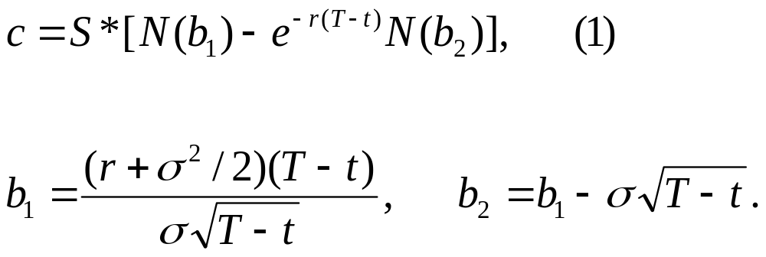
The Forward Pricing Model: Without Restricted exercise price r is risk free rate, the duration of the ESO is T-t, is stock volatility, S_{t} is the closing price of the underlying share on the issuance day, C is the price of share option on the issuance day. t is the interval between the announcement date and issuance date. (Robinstein (1991)).

Slide 23
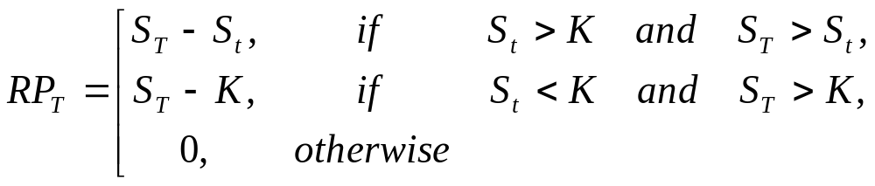
ESOs with the restricted
exercise price provision
If the ESO’s plan exists the restriction price of ESOs(K) , which is par value. If the price on issuing day is under par value, which is NT$10 per unit, the ESO’s exercise price is NT$10 and not the same with issuing day price. If the offering price is decided by issuing day stock price St, we can evaluate ESOs under risk-neutral. If the risk-free rate is r% per year, the period from announcing to issuing is t years and the duration of ESO is (T-t) years, the payoff of ESOs (RPt) on the exercising day is that:

Slide 24
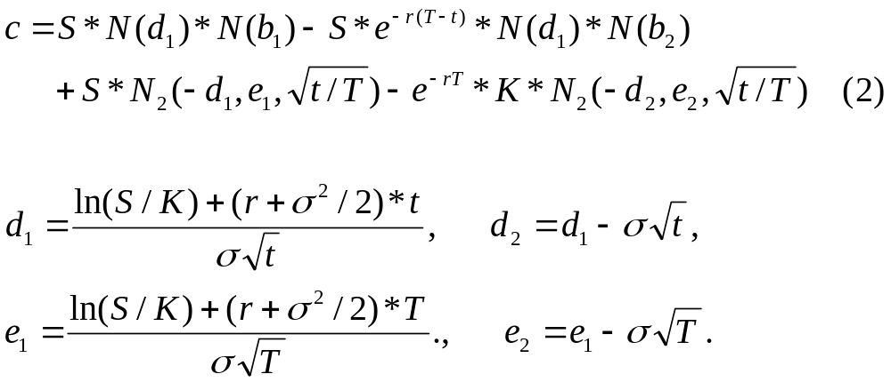
ESOs with the restricted exercise price provision
K is the offering price bottom line and equals NT$10, which is the par value of the stock in Taiwan. (See Gray and Whaley (1997) Reset option pricing model.

Slide 25
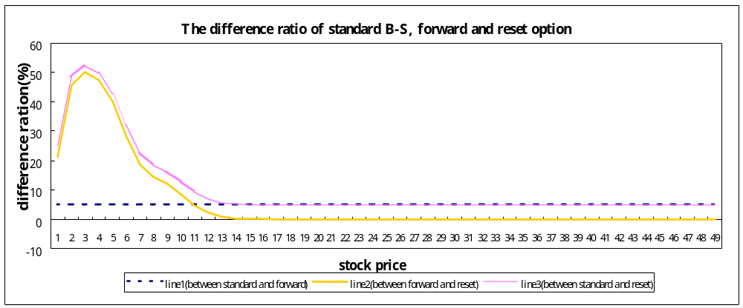
Forward and Reset
Pricing Model Simulation
We find that the B-S model has over-estimated the option value by 4.78% in comparison to the forward option model. Line 2 shows the effect of setting a restricted price on the ESO in both the forward option and reset models, showing the change of ESOs’ value with a restricted price. We can see that the difference is almost zero when the underlying asset price is above $14 and the difference (in percentages) is almost 50% when the stock price is around $4. Therefore we conclude that if the underlying share price is below the par value when the ESOs are issued, the restricted price provision brings an impact on the employee options price.

Slide 26
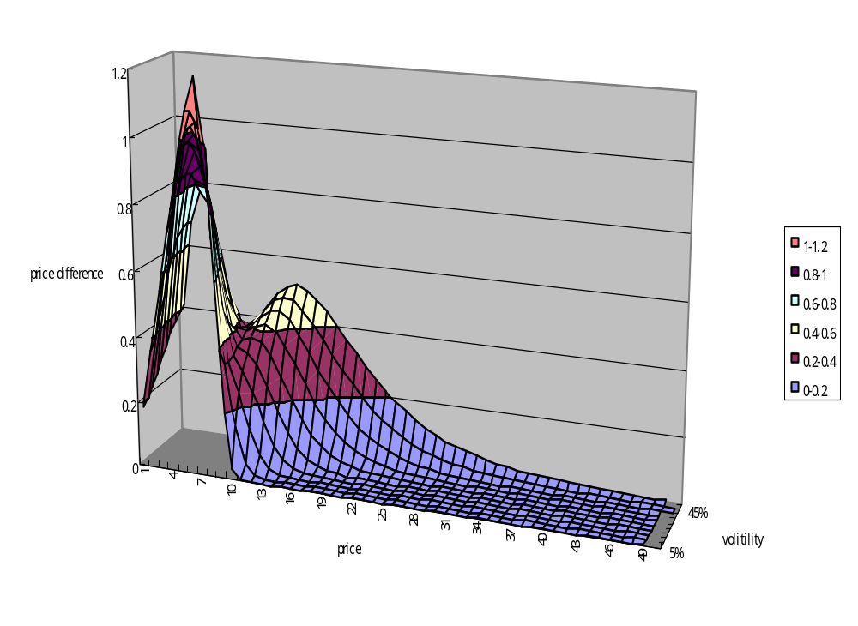

Slide 27
Factors that Determine the Decision of Imposing
Restricted Exercise Price on ESOs
Operational performance: Gaver and Gaver (1995)
Liquidity: Core and Guay (2001)
---Salary compensation
---Financial Distress
Growth Rate: Loughran and Ritter (1997)
Agency Problem: Christie et.al. (1994)
Recent Share Performance

Slide 28
Why firm issue ESOs?
Ding and Sun (2001), Miller and Scholes (1982). Yermack (1995), Matsunaga (1995), merely in the Executive SOs issuance.
1. Tax saving: lower rate compare to bonus or salary.
2. Reduce financial reporting cost, replace the additional salary and bonus payments.
3. Reduce agency problem by making managers as shareholders.

Slide 29
Role of Restricted exercise price
Regulations Governing the Offering and Issuance of Securities by Securities Issuers N0. 58
Firms are allowed to issue employee stocks options with an exercise price lower than the issuance date underlying share closing price.
Restricted exercise price (執行價不得低於面額)
If the underlying share closed at a lower than face value (NT$10) on the issuance date; the exercise price can be reset at the face value (NT$10).

Slide 30
Factors that Determine the Imposition of a Restricted Exercise Price on ESOs
The Logit Model
Limit it = β₀+ β₁* Business Achievement _{it} + β₂*LIQ_{it} + β₃ * GC_{it} + Β₄ * Market Performance_{it} + β₅ *Size_{it}

Slide 31
Factors that Determine Imposition of a Restricted Exercise Price on ESOs
Limit：If Limit=1, the company with the provision of the restriction of exercise price of ESOs; if Limit=0, the company without the provision of the restriction of exercise price of ESOs
BA：Company’s Business achievement (Operational Performance): (1) Earning Per Share (EPS) at the time, ( 2 ) ROA
LIQ：The company’s liquidity：（1）current ratio
（2）times interest earned

Slide 32
Factors that Determine the Imposition of a Restricted Exercise Price on ESOs
GC：Growth of the company：（1）the rate of sale growth（2）the rate of total asset growth（3）the rate of research and development expense. (4) internal retention rate
MP: Market performance of the company: ( 1）stock price on the announcement day (2) the stock return of 30-day before announcement date (3) the volatility of stock price of 30-day before announcement date.
SIZE：The company’s total asset.

Slide 33
Sample Selection
Companies issued ESO’s in the Taiwanese market
Period: 2000 to 2002
89 listed in Taiwan Stock Exchange
74 listed in Gre Tai Securities Market (OTC)
98 out of 163 issued ESO’s have been selected after excluding missing data.
69/98 issued with Restricted Exercise Price
29/98 issued without Restricted Exercise Price

Slide 34
Descriptive Statistics
Variable
Total Sample
With the Provision
Without the Provision
N
98
69
29
Size( thousand NT dollars)
46008.8
25635.1
99484.3
Business Achievement
ROA
0.60
0.71
0.34
EPS
0.16
0.20
0.08
Liquidity
Current ratio
252.70
264.25
225.20
Times interest earned
813.57
348.41
1920.33
Growth of the Company
Rate of Sale Growth
8.57
9.24
6.96
Rate of Total Asset Growth
14.00
13.75
14.62
Research and Development Expense(thousand NT dollars)
334455.58
304043.18
404718.72
Internal Retention Rate
8.34
-7.57
49.00
Market Performance
Stock Price
30.58
29.40
33.53
Stock Price Return (30Days)
0.01
0.06
-0.10
Standard Deviation of Stock Price（30Days）
0.17
0.19
0.12

Slide 35
Empirical Analysis
H1: Operational Performance-----Confirmed
H3: Liquidity—Financial Distress-Confirmed
H6: Share Performance------------Confirmed
Independent Variables | BA | LIQ | GC | MP | SIZE
Expected Sign | + | +/- | + | +/- | +/-

Slide 36
Conclusion
Why Restrict Exercise in ESO’s Issuance?
Is Current Accounting Standard Appropriate?
Factors that Determine the Imposition of a Restricted Exercise Price
Puzzle of Agency Problem

Slide 37
Finally………….
All suggestions are truly appreciated.
THANK YOU ! !

